Slide 1
Unit-1
Introduction to Machine Learning

Slide 2
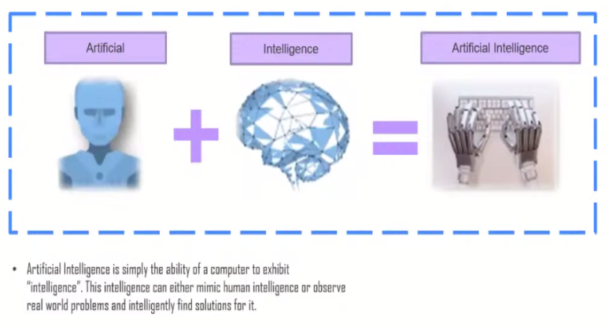
Artificial intelligence

Slide 3
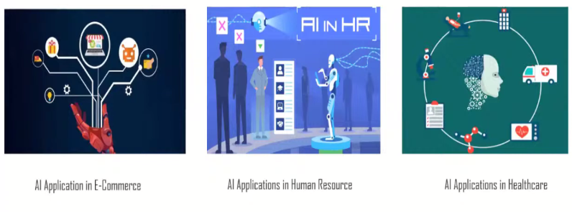
Application of Artificial intelligence

Slide 4
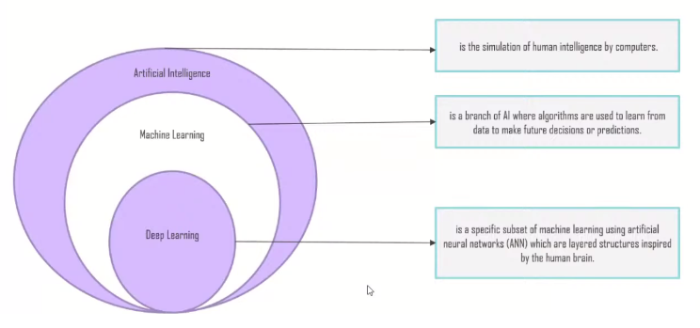
Artificial intelligence

Slide 5
Introduction of machine learning
Arthur Samuel, an early American leader in the field of computer gaming and artificial intelligence, coined the term “Machine Learning ” in 1959 while at IBM.
He defined machine learning as
“the field of study that gives computers the ability to learn without being explicitly programmed”.

Slide 6
A computer program is said to learn from experience E with respect to some class of tasks T and performance measure P, if its performance at tasks T, as measured by P, improves with experience E.
Example: Handwriting recognition learning problem
Task T : Recognizing and classifying handwritten words within images
Performance P : Percent of words correctly classified
Training experience E : A dataset of handwritten words with given classifications

Slide 7
A computer program which learns from experience is called a machine learning program or simply a learning program .

Slide 8
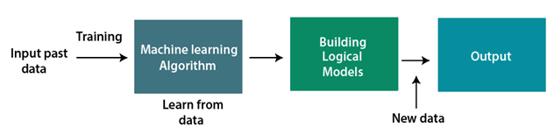
How does Machine Learning work
Machine learning algorithms create a mathematical model that, without being explicitly programmed, aids in making predictions or decisions with the assistance of sample historical data, or training data. For the purpose of developing predictive models, machine learning brings together statistics and computer science. Algorithms that learn from historical data are either constructed or utilized in machine learning.

Slide 9
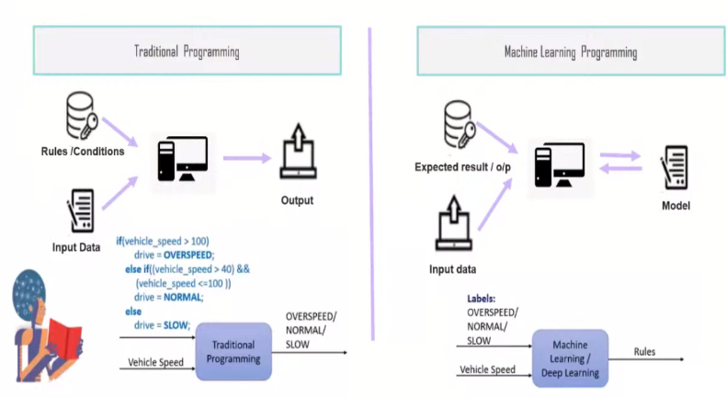
Difference between machine learning and traditional programming

Slide 10
Features of Machine Learning:
Machine learning uses data to detect various patterns in a given dataset.
It can learn from past data and improve automatically.
It is a data-driven technology.
Machine learning is much similar to data mining as it also deals with the huge amount of the data.

Slide 11
Need for Machine Learning
Rapid increment in the production of data
Solving complex problems, which are difficult for a human
Decision making in various sector including finance

Slide 12
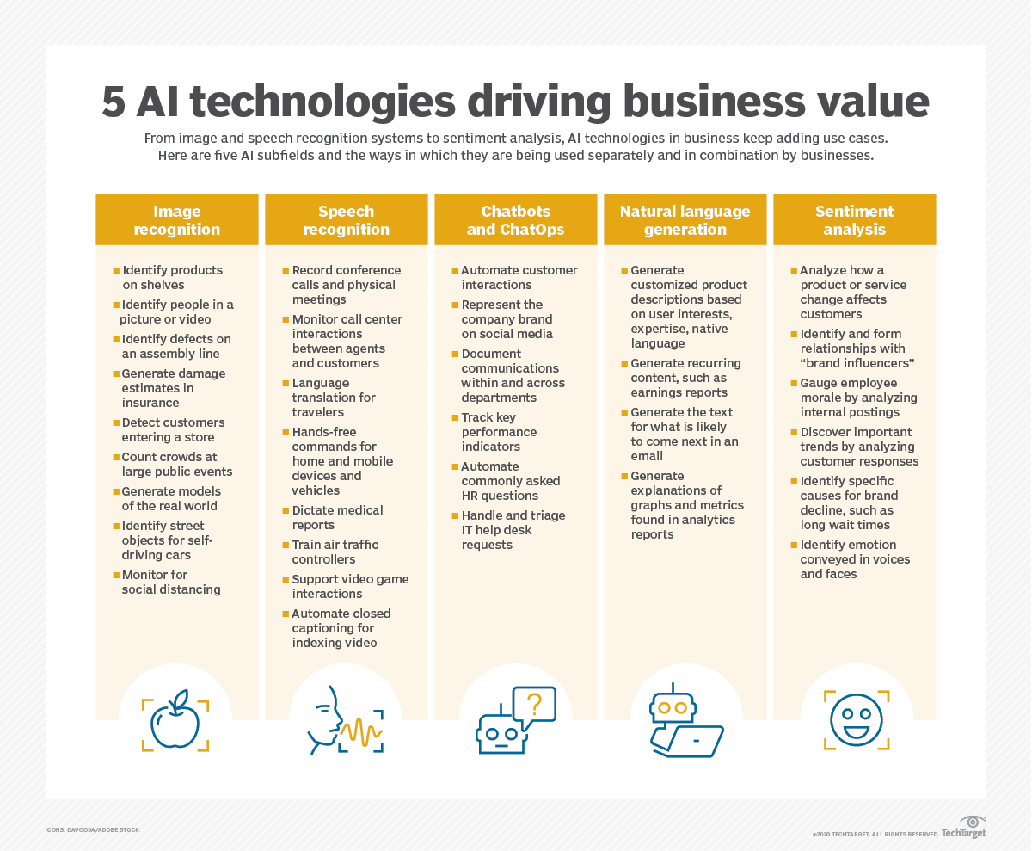

Slide 13
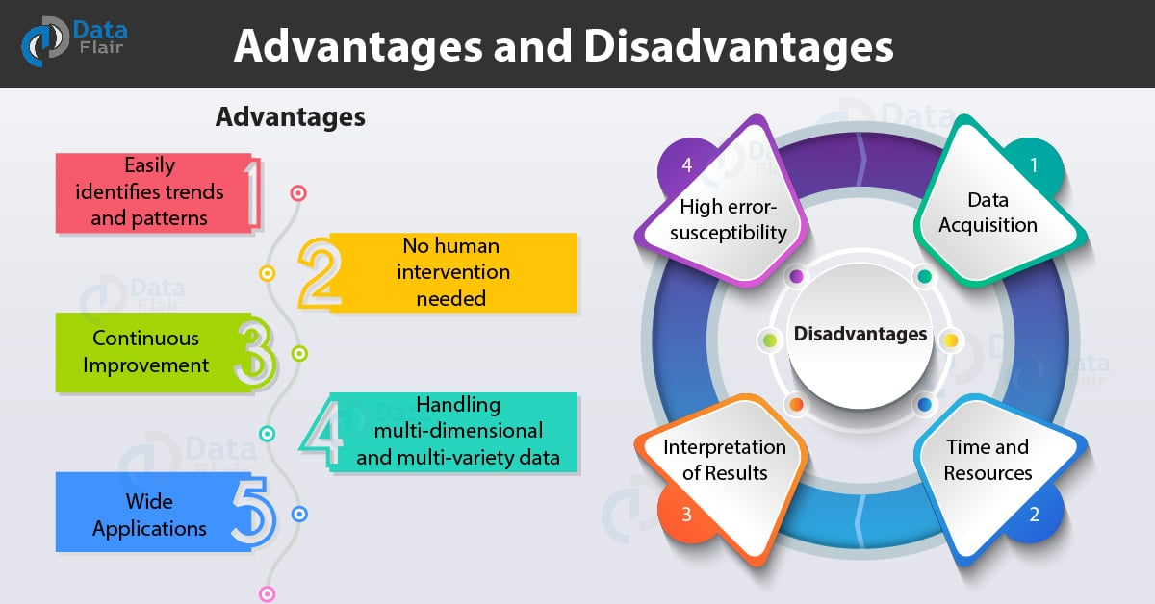

Slide 14
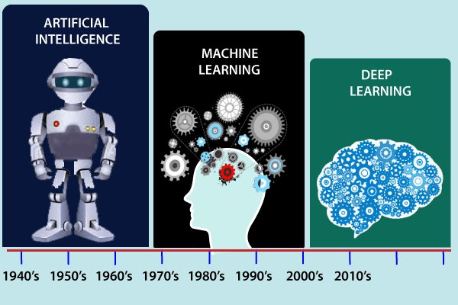
History of Machine Learning

Slide 15
Computer machinery and intelligence:
1950: In 1950, Alan Turing published a seminal paper, "Computer Machinery and Intelligence," on the topic of artificial intelligence. In his paper, he asked, "Can machines think?"
Machine intelligence in Games:
1952: Arthur Samuel, who was the pioneer of machine learning, created a program that helped an IBM computer to play a checkers game. It performed better more it played.
1959: In 1959, the term "Machine Learning" was first coined by Arthur Samuel.
The first "AI" winter:
The duration of 1974 to 1980 was the tough time for AI and ML researchers, and this duration was called as AI winter.
In this duration, failure of machine translation occurred, and people had reduced their interest from AI, which led to reduced funding by the government to the researches.

Slide 16
Machine Learning at 21st century
2007:
Participants were tasked with increasing the accuracy of Netflix's recommendation algorithm when the Netflix Prize competition began.
Support learning made critical progress when a group of specialists utilized it to prepare a PC to play backgammon at a top-notch level.
2008:
Google delivered the Google Forecast Programming interface, a cloud-based help that permitted designers to integrate AI into their applications.
Confined Boltzmann Machines (RBMs), a kind of generative brain organization, acquired consideration for their capacity to demonstrate complex information conveyances.
2010:
The ImageNet Huge Scope Visual Acknowledgment Challenge (ILSVRC) was presented, driving progressions in PC vision, and prompting the advancement of profound convolutional brain organizations (CNNs).
2012:
AlexNet, a profound CNN created by Alex Krizhevsky, won the ILSVRC, fundamentally further developing picture order precision and laying out profound advancing as a predominant methodology in PC vision.

Slide 17
Machine Learning at 21st century
2017:
Move learning acquired noticeable quality, permitting pretrained models to be utilized for different errands with restricted information.
Better synthesis and generation of complex data were made possible by the introduction of generative models like variational autoencoders (VAEs) and Wasserstein GANs.
These are only a portion of the eminent headways and achievements in AI during the predefined period. The field kept on advancing quickly past 2017, with new leap forwards, strategies, and applications arising.

Slide 18
Machine Learning at present:
The field of machine learning has made significant strides in recent years, and its applications are numerous, including self-driving cars, Amazon Alexa, Catboats, and the recommender system. It incorporates clustering, classification, decision tree, SVM algorithms, and reinforcement learning, as well as unsupervised and supervised learning.
Present day AI models can be utilized for making different expectations, including climate expectation, sickness forecast, financial exchange examination, and so on.

Slide 19
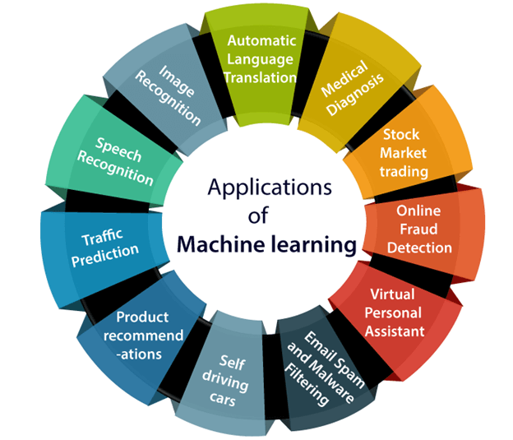

Slide 20
Machine Learning lifecycle:
Step-1
Study the Problem
Step-2
Data Collection
Step-3
Data Preparation
Step-4
Model Selection
Step-5
Model building and Training
Step-6
Model Evaluation
Step-7
Model Tuning
Step-8
Deployment

Slide 21
Types of Machine Learning
Supervised Machine Learning
Unsupervised Machine Learning
Semi-Supervised Machine Learning
Reinforcement Machine Learning

Slide 22
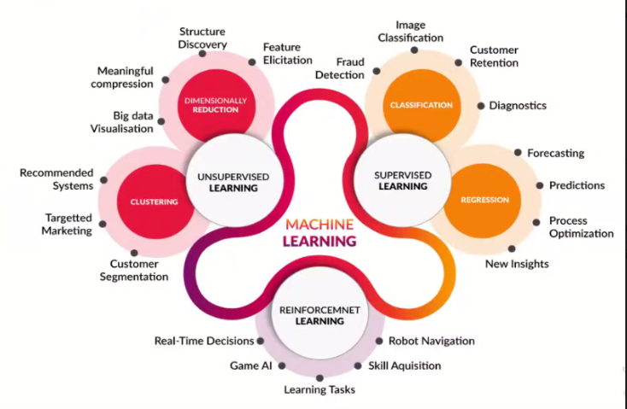

Slide 23
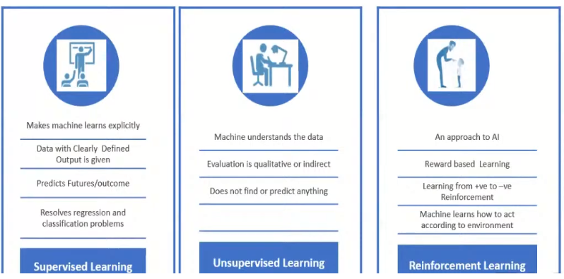

Slide 24
Supervised Machine Learning
Supervised learning is the types of machine learning in which machines are trained using well "labelled" training data, and on basis of that data, machines predict the output. The labelled data means some input data is already tagged with the correct output.
In supervised learning, the training data provided to the machines work as the supervisor that teaches the machines to predict the output correctly. It applies the same concept as a student learns in the supervision of the teacher.

Slide 25
Supervised Machine Learning
Supervised learning is a process of providing input data as well as correct output data to the machine learning model. The aim of a supervised learning algorithm is to find a mapping function to map the input variable(x) with the output variable(y).
In the real-world, supervised learning can be used for Risk Assessment, Image classification, Fraud Detection, spam filtering, etc.

Slide 26
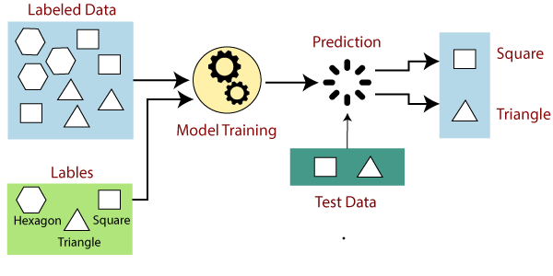
Supervised Machine Learning

Slide 27
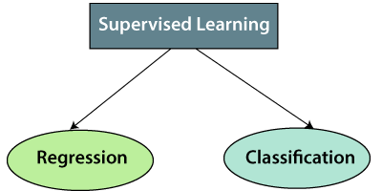

Slide 28
Regression
Regression algorithms are used if there is a relationship between the input variable and the output variable. It is used for the prediction of continuous variables, such as Weather forecasting, Market Trends, etc. Below are some popular Regression algorithms which come under supervised learning:
Linear Regression
Regression Trees
Non-Linear Regression
Bayesian Linear Regression
Polynomial Regression

Slide 29
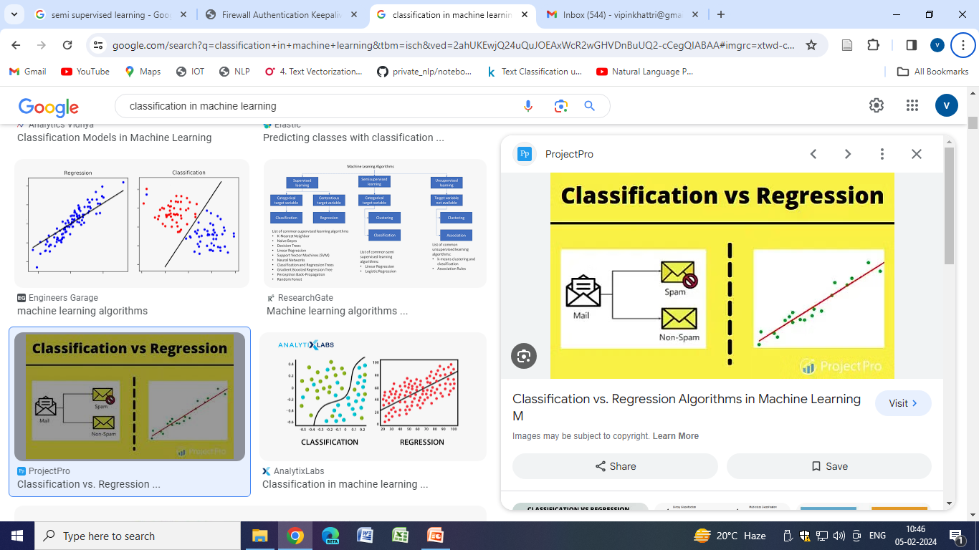
Regression

Slide 30
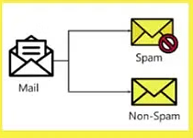
Classification

Slide 31
Classification
Classification algorithms are used when the output variable is categorical, which means there are two classes such as Yes-No, Male-Female, True-false, etc. Spam Filtering is an example of classification, The following algorithms are used for classification
Random Forest
Decision Trees
Logistic Regression
Support vector Machines

Slide 32
unsupervised learning
Unsupervised learning is a machine learning technique in which models are not supervised using training dataset. Instead, models itself find the hidden patterns and insights from the given data. It can be compared to learning which takes place in the human brain while learning new things. It can be defined as:
Unsupervised learning is a type of machine learning in which models are trained using unlabeled dataset and are allowed to act on that data without any supervision.

Slide 33
unsupervised learning
Unsupervised learning cannot be directly applied to a regression or classification problem because unlike supervised learning, we have the input data but no corresponding output data. The goal of unsupervised learning is to find the underlying structure of dataset, group that data according to similarities, and represent that dataset in a compressed format.

Slide 34
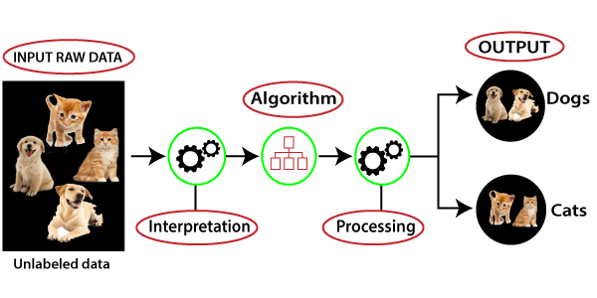
unsupervised learning

Slide 35
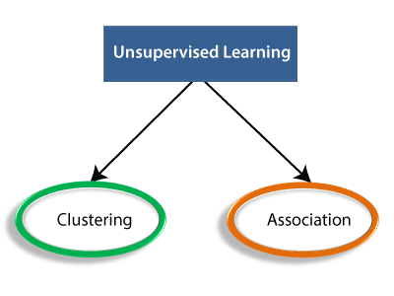

Slide 36
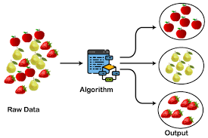
Clustering:

Slide 37
Clustering:
Clustering is a method of grouping the objects into clusters such that objects with most similarities remains into a group and has less or no similarities with the objects of another group. Cluster analysis finds the commonalities between the data objects and categorizes them as per the presence and absence of those commonalities.

Slide 38
Association:
An association rule is an unsupervised learning method which is used for finding the relationships between variables in the large database. It determines the set of items that occurs together in the dataset. Association rule makes marketing strategy more effective. Such as people who buy X item (suppose a bread) are also tend to purchase Y (Butter/Jam) item. A typical example of Association rule is Market Basket Analysis.

Slide 39
Unsupervised Learning algorithms:
K-means clustering
KNN (k-nearest neighbors)
Hierarchal clustering
Anomaly detection
Neural Networks
Principle Component Analysis
Independent Component Analysis
Apriori algorithm
Singular value decomposition

Slide 40
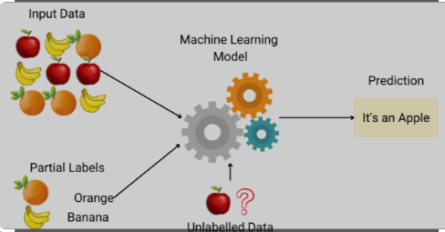
Semi-Supervised Machine Learning

Slide 41
Semi-Supervised Machine Learning
Semi-supervised machine learning is a machine learning approach that falls between supervised learning and unsupervised learning.
It is particularly useful when a labeled dataset is small but a larger set of unlabeled data is available.
This approach leverages the power of both labeled and unlabeled data to build better models when acquiring a fully labeled dataset is too expensive or time-consuming.

Slide 42
Semi-Supervised Machine Learning
Semi-supervised learning is a hybrid learning approach that uses both labeled and unlabeled data to train machine learning models.
In many real-world scenarios, obtaining a large set of labeled data can be costly and labor-intensive.
However, unlabeled data is often abundant and cheaper to collect.
Semi-supervised learning combines a small amount of labeled data with a large amount of unlabeled data during the training process.

Slide 43
How Does Semi-Supervised Learning Work?
There are several techniques used in semi-supervised learning, including self-training, co-training, and transductive learning.
Self-training, for example, starts with a supervised learning algorithm to train a model on the labeled data, then uses this model to predict labels for the unlabeled data.
The most confident predictions are then added to the training set, and the model is retrained with this augmented dataset.

Slide 44
Benefits of Semi-Supervised Learning
The primary benefit of semi-supervised learning is that it can improve learning accuracy with less labeled data.
This is particularly important in domains where labeling data is expensive or requires expert knowledge, such as medical imaging or speech recognition.
By utilizing the structure or distribution information present in the unlabeled data, semi-supervised learning can provide a significant improvement over supervised learning alone.

Slide 45
Challenges of Semi-Supervised Learning
One of the challenges with semi-supervised learning is the assumption that the labeled and unlabeled data come from the same distribution. If this assumption does not hold, the model's performance can degrade.
Additionally, if the initial labeled data is not representative of the overall distribution, the model may learn incorrect patterns.
Another challenge is the risk of propagating errors. If the model incorrectly labels some of the unlabeled data and then uses these labels for further training, it can reinforce these errors, leading to a decrease in overall performance.

Slide 46
Applications of Semi-Supervised Learning
Image and Video Analysis:For tasks like object detection and facial recognition, where manual labeling is time-consuming.
Natural Language Processing: In sentiment analysis or language translation, where the nuances of language make labeling challenging.
Medical Diagnosis: For medical image classification, where expert annotations are costly and limited.
Web Content Classification: To categorize web pages or documents when only a small subset has been labeled.

Slide 47
Supervised Learning | Unsupervised Learning
Supervised learning algorithms are trained using labeled data. | Unsupervised learning algorithms are trained using unlabeled data.
Supervised learning model takes direct feedback to check if it is predicting correct output or not. | Unsupervised learning model does not take any feedback.
Supervised learning model predicts the output. | Unsupervised learning model finds the hidden patterns in data.
In supervised learning, input data is provided to the model along with the output. | In unsupervised learning, only input data is provided to the model.

Slide 48
Supervised Learning | Unsupervised Learning
The goal of supervised learning is to train the model so that it can predict the output when it is given new data. | The goal of unsupervised learning is to find the hidden patterns and useful insights from the unknown dataset.
Supervised learning needs supervision to train the model. | Unsupervised learning does not need any supervision to train the model.
Supervised learning can be categorized in Classification and Regression problems. | Unsupervised Learning can be classified in Clustering and Associations problems.

Slide 49
Supervised Learning | Unsupervised Learning
Supervised learning can be used for those cases where we know the input as well as corresponding outputs. | Unsupervised learning can be used for those cases where we have only input data and no corresponding output data.
Supervised learning model produces an accurate result. | Unsupervised learning model may give less accurate result as compared to supervised learning.

Slide 50
Supervised Learning | Unsupervised Learning
Supervised learning is not close to true Artificial intelligence as in this, we first train the model for each data, and then only it can predict the correct output. | Unsupervised learning is more close to the true Artificial Intelligence as it learns similarly as a child learns daily routine things by his experiences.
It includes various algorithms such as Linear Regression, Logistic Regression, Support Vector Machine, Multi-class Classification, Decision tree, Bayesian Logic, etc. | It includes various algorithms such as Clustering, KNN,

Slide 51
Reinforcement Learning
Reinforcement Learning is a feedback-based Machine learning technique in which an agent learns to behave in an environment by performing the actions and seeing the results of actions. For each good action, the agent gets positive feedback, and for each bad action, the agent gets negative feedback or penalty.
In Reinforcement Learning, the agent learns automatically using feedbacks without any labeled data, unlike supervised learning.
Since there is no labeled data, so the agent is bound to learn by its experience only.

Slide 52
Reinforcement Learning
RL solves a specific type of problem where decision making is sequential, and the goal is long-term, such as game-playing, robotics, etc.
The agent interacts with the environment and explores it by itself. The primary goal of an agent in reinforcement learning is to improve the performance by getting the maximum positive rewards.

Slide 53
Reinforcement Learning
The agent learns with the process of hit and trial, and based on the experience, it learns to perform the task in a better way. Hence, we can say that "Reinforcement learning is a type of machine learning method where an intelligent agent (computer program) interacts with the environment and learns to act within that." How a Robotic dog learns the movement of his arms is an example of Reinforcement learning.

Slide 54
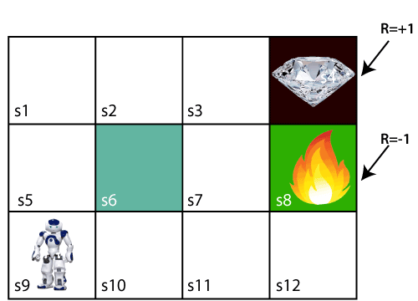
Reinforcement Learning

Slide 55
Terms used in Reinforcement Learning
Agent(): An entity that can perceive/explore the environment and act upon it.
Environment(): A situation in which an agent is present or surrounded by. In RL, we assume the stochastic environment, which means it is random in nature.
Action(): Actions are the moves taken by an agent within the environment.
State(): State is a situation returned by the environment after each action taken by the agent.
Reward(): A feedback returned to the agent from the environment to evaluate the action of the agent.
Policy(): Policy is a strategy applied by the agent for the next action based on the current state.
Value(): It is expected long-term retuned with the discount factor and opposite to the short-term reward.

Slide 56
